Slide 1
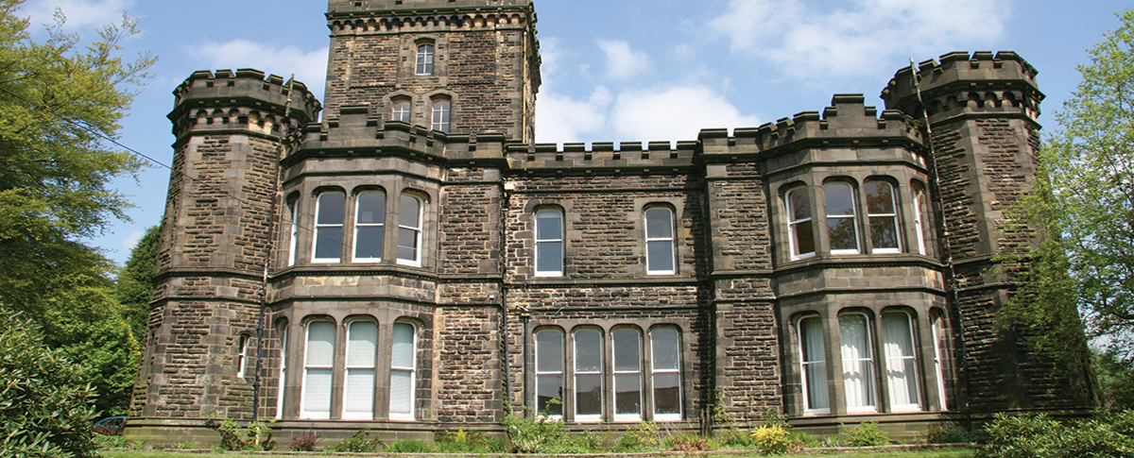
Robinwood – Wednesday 19th to Friday 21st March
Dobroyd Castle, Todmorden, Lancashire

Slide 2
General Information
28 pupils from Year 5 and 6 will be attending.
Spilt into three activity groups.
Each group assigned a Robinwood instructor and supported by a member of staff from school.
Proposed members of staff - Mrs. Haffey, Mrs. Ingle & Mrs. Jones.

Slide 3
Overnight Accommodation
The children sleep in dormitories – yet to be allocated.
Boys and Girls are on different floors and have access to different washing and toilet facilities.
Showers and toilet facilities are located on each floor and shared between the members of our school.

Slide 4
Medicines
Please ensure a Child Personal Information Form is completed and returned by Friday 7th March.
All medicines to be handed to either Mrs. Haffey or Mrs. Ingle on the Wednesday morning before boarding the coach. Please ensure these are clearly labelled and in sealed container or equivalent.
Please ensure travel sickness tablets, or equivalent, are taken in the morning to ensure they are working before boarding the coach at 9:10am.

Slide 5
Daily Overview
7am - Wake up call
8am - Breakfast
9am - 5pm – Activities (lunch is served at approximately 12:30pm)
5 - 6pm – Evening meal
6 - 9pm - Evening activities
9 - 10pm – Debrief followed by bed
It is really important that the children have a good night’s sleep as the days are very busy.
Detailed risk assessments of all activities and areas at Robinwood are continually updated. Risk assessments are carried out before each activity to take account of the needs of the children in that group.

Slide 6
Food
Breakfast – full cooked breakfast as well as toast and cereals
Lunch – wrap or jacket potatoes with fillings, sandwiches, soup, fruit and yoghurts.
Evening meal – cooked food – pizza, spaghetti bolognese and a dessert!
Snacks available at break times.
There is always a vegetarian meal available (all Robinwood activity centres are nut free).

Slide 7
Additional Information
Depart on Wednesday 19th March at 9:10am – children arrive at normal school time and will meet in the hall with their bags.
Bags should be named and children aware of clothes/items packed within them (please don’t pack sweets and treats as there will be no time for the children to eat them).
There is approximately a half-an-hour walk to Dobroyd Castle.
A packed lunch will be PROVIDED at Robinwood.
Children will need to be able to carry/move their own bags from the coach to the accommodation.
No electrical equipment should be taken on the residential; it’s more than fine for the children to bring a book.
It’s useful for the children to be able to make a bed prior to the visit.

Slide 8
Returning to School
We will be returning to School at approximately 4pm on Friday 21st March. Mrs. Greening will be informed of any delays etc.
Expectations
To follow instructions.
To keep themselves and everyone else safe.
To challenge themselves.
To be an effective team member.
To take responsibility for their own property.
To be helpful to others.
To respect other peoples privacy and property.
To be an outstanding ambassador for the school.
Please access our Twitter account (@ElvingtonCE) to keep up to date with all things Robinwood.

Slide 9
Suggested Clothing List
Please see the clothing list and parent/carer information booklet on our website; a copy of this PowerPoint will also be available.
Please do not bring any aerosol sprays. The fire alarm system is sensitive, in order to ensure high standards of fire safety, and aerosols sprayed near any of the many smoke alarm sensors can set off the fire alarm.
A maximum of £10 can be taken to allow the children to purchase souvenirs (this should be sealed in a clearly marked envelope).
A set of waterproof cagoules and over trousers are issued to each child upon arrival.
Specialist equipment including buoyancy aids, helmets and harnesses are provided.

